Slide 1
Implementation of the
Minimax Algorithm for Chess
using Google App Engine
Team #2
Geetika Garg, David Smith,
& Zayd Hammoudeh

Slide 2
Minimax Algorithm Overview
Minimax
AI algorithm for determining an optimal strategy in deterministic, two player games.
Traditional Implementation:
Build a decision tree recursively
Search through the tree to find an optimal solution
Alpha-beta Pruning
A standard Minimax decision tree grows at a rate of O(b^{d}).
b – Branching factor (i.e. number of children per node)
d – Depth of the tree
Through Alpha-beta pruning, the average complexity of Minimax can be reduced to O(b^{d/2}) – a substantial improvement.
Notes:
Tree can be very large

Slide 3
Project Goals and Challenges
Project Goal:
Develop a distributed implementation
of the Minimax Algorithm with Alpha-beta
Pruning for Chess in the Cloud
While Minimax was first proposed in 1928, running it in the cloud presents a unique set of challenges.

Slide 4
Challenges of Running Parallel Minimax in the Cloud

Slide 5
Review of a Traditional Minimax Decision Tree
A Decision Tree is a type of rooted tree.
The root node represents the current state.
The current node can have a set of successor states (i.e. child nodes)
Successor states can have their own additional successor states.
Leaf nodes model terminal states and generally have an associated utility.
Model Decision Tree

Slide 6
Recursively Iterating through a Decision Tree
Tree search algorithms like Minimax traditionally traverse through the tree recursively.
Advantages of Recursive Search:
Simple implementation paradigm
Minimal memory footprint: O(d)
Disadvantages of Recursive Search:
Limited opportunity for increased throughput via parallelism
No scalability
Iterating through a Decision Tree

Slide 7
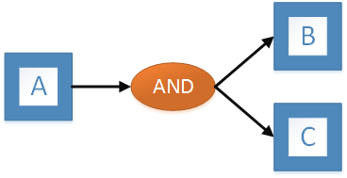
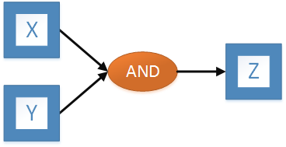
Parallelizing Minimax and Recursive Search: A New Solution
Observation: By mirroring the decision tree along the leaf nodes, the Minimax tree becomes a directed acyclic graph (DAG). This eliminates the algorithm’s dependence on recursion.
Solution: Modify the Minimax algorithm to behave as a workflow with nested AND Splits and Synchronization Joins.
AND Split
Synchronization Join
Notes:
Map Reduce and Finite State Machines do not work well for this.

Slide 8
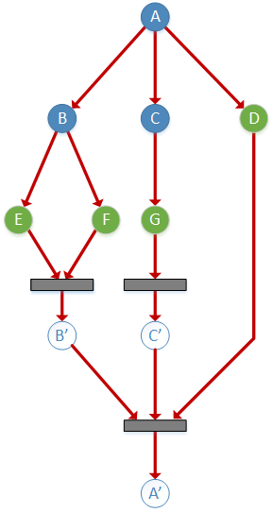
Solution: Workflow-Based Directed Acyclic Graph (DAG)
Workflow-Based DAG
Recursive Decision Tree
Notes:
Geetika will describe how we implemented this in our algorithm.

Slide 9
System Architecture and Implementation

Slide 10
Cloud-Based Minimax System Architecture
Four Primary Architecture Components
Chess Rules Implementation (not pictured) | 2. Client Application
3. Server-side Application | 4. RESTful Communication

Slide 11
Chess Legal Moves and “Check” Functionality
Implementer: David Smith
Programming Language: Python 2.7.8
For chess to be playable on a computer, the program must know the game rules. Examples include:
“Check” – Determines whether the opponent is attacking a player’s king.
Legal Moves – Determines the set of moves the current player can make.
Chess rules related functionality is required on both the client and server sides of the application. Hence, both sides of the application were written in Python to eliminate code and test duplication.
System architecture supports multiple board sizes.
Importance of Efficiency: The chess related functions are run at each node in the Minimax tree so efficiency is critical for this portion of the application.
Notes:
David will mention everything is written in Python.

Slide 12
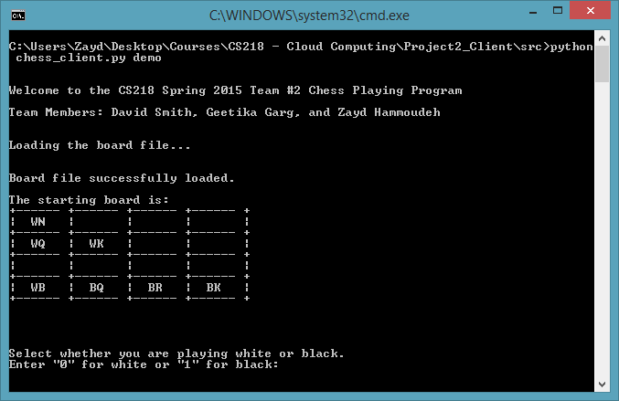
Client Application
Implementer: Geetika Garg & Zayd Hammoudeh
Programming Language: Python 2.7.8
Role: Provide the interface between the human player and the Google App Engine (GAE) server application.
Interface: Terminal Based
Basic Flow of Operation:
Loads and displays the board file for the user.
User selects a player color (e.g. black or white)
Turns alternate between the human player and the computer
Application sends requests to the server and processes the responses.
Client Console Application

Slide 13
Stateless Server Application
Implementer: Zayd Hammoudeh
Programming Language: Python 2.7.8
Cloud Feature: Google App Engine (GAE) and Python’s webapp2 Class
Server Address: http://cs218-team2-chess-minimax.appspot.com
Python’s webapp2 class is a lightweight web framework.
Server Roles:
Receives and processes incoming client requests
Initiates the Minimax algorithm.
Once the algorithm is complete, it generates a response to send to the client application.
Benefits of a Stateless Architecture:
Implementation simplicity
Reduced memory footprint
No reduction in system capability

Slide 14
Implementing the Parallel Minimax Algorithm
Implementer: Zayd Hammoudeh & Geetika Garg
Programming Language: Python 2.7.8
Cloud Feature: GAE’s Pipeline API and GAE’s Push Task Queue
The GAE’s Pipeline API provides a framework to create dynamic workflows using GAE’s Push Task Queue.
We used the Pipeline API to model the parallel Minimax tree as a DAG. Each node in the Minimax tree is an object of type “Pipeline.”
Benefits of the Pipeline API:
Supports non-deterministic task structures.
Coordinates the passing of arguments from parent to child tasks and the directing of output/results to synchronization joins.
Automated elastic scaling
Notes:
Mention the tools used
Pipeline API is the framework

Slide 15
Server-Side Caching
Implementer: Geetika Garg
Programming Language: Python 2.7.8
Cloud Feature: GAE’s Memcache
In most Minimax trees, there are often duplicate nodes in the graph. Recalculating duplicate nodes wastes both system resources and time.
Solution: Implement a caching system in the server application to store recent or frequently calculated values in case they are needed in the future.
Benefits of Caching:
Improved performance of recent or frequent requests
Bounded memory footprint (GAE’s Memcache can be 1GB to 20GB in size)
High throughput (GAE’s Memcache supports up to 10,000 requests per second)

Slide 16
Alpha-beta Pruning
Implementer: Geetika Garg & Zayd Hammoudeh
Programming Language: Python 2.7.8
Cloud Feature: GAE’s Memcache and Pipeline API
Alpha-beta Pruning is a technique for reducing the size of Minimax decision trees.
It is trivially implemented in the recursive algorithm, but it is much more complex to perform efficiently in distributed systems due to the need to share results across nodes at the same level of the tree.
Solutions:
Batch Processing: When a node has a large number of children, divide the children into sequential batches to see if the tree can be pruned and some children ignored.
Caching: By placing calculation results into the central Memcache, data can be shared between nodes in the tree without direct communication.

Slide 17
RESTful Communication Interface
Implementer: Zayd Hammoudeh
Programming Language: Python 2.7.8
Cloud Feature: Python’s urlib and urlib2 Web Libraries
Communication Protocol: HTTP
Basic Flow of Operation:
Client makes an HTTP POST request to the server with the board, current player, and the Minimax parameters (e.g. tree search depth)
Server processes the request
Server sends its response as a string in the form:
“SourceLocation, DestinationSquare”
Notes:
Lead into that David

Slide 18
DEMO

Slide 19
For the demo, we will need a volunteer from the class who knows how to play chess.

Slide 20
Chess Pieces in the Console Application
Board Symbol | ♟ | ♞ | ♝ | ♜ | ♛ | ♚
Piece Name | Pawn | Knight | Bishop | Rook | Queen | King
In-Game Symbol | P | N | B | R | Q | K
In-Game Symbol: Represents the letter used to denote each game piece in our console application.
Color Prefix: Chess is a two player game of white and black pieces. White pieces in the console application are prefixed with a “W” while black pieces are prefixed with a “B”.
Example Piece Notation:
“WB” – White Bishop
“BN” – Black Knight

Slide 21
Simplified Game Board for the Demo
White’s Pieces
One Knight
One Queen
One Bishop
One King
♘
♕ | ♔
♗ | ♛ | ♜ | ♚
Black’s Pieces
One Queen
One Rook
One King
White is in check and must make the next move

Slide 22
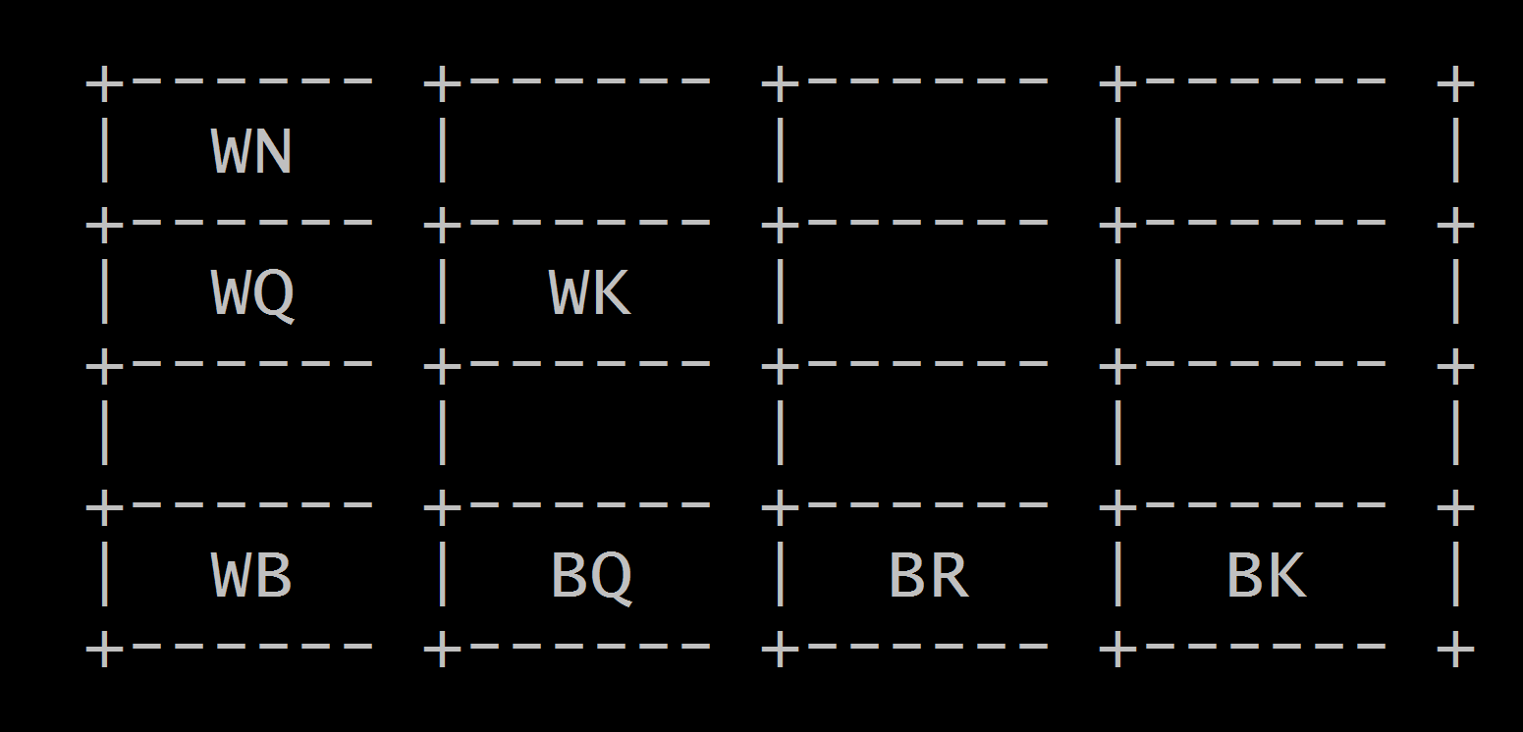
Demo Board as Displayed in the Console
White’s Pieces
One Knight
One Queen
One Bishop
One King
Black’s Pieces
One Queen
One Rook
One King

Slide 23
Making a Move in the Game
♘
♕ | ♔
♗ | ♛ | ♜ | ♚
♘ |  | ♜
♕ | ♔
♗ | ♛ |  | ♚
0 | 1 | 2 | 3
4 | 5 | 6 | 7
8 | 9 | 10 | 11
12 | 13 | 14 | 15
14, 2
Demo Board
Board Square Numbering Scheme
Moves in the game are specified in the format:
CurrentSquareNumber NewSquareNumber
Example: What would be the input if I wanted to move the black rook from the bottom row to the top row?
,

Slide 24
Client Application

Slide 25
Final Thoughts & Conclusions

Slide 26
Conclusions and Final Thoughts
Transforming a recursive, decision tree into a DAG is a powerful paradigm, but it has limitations.
The creation of new tasks, sending the data to the processing nodes in the system, and joining the results all have overhead.
In cases of fine grain parallelism like chess Minimax, the overhead associated with the workflow usually becomes prohibitive.
Once a lower overhead workflow tool exists, the paradigm and techniques we described would merit much greater study.

Slide 27
Appendix
27

Slide 28
Potential Future Improvements
Techniques for improvement of our system include:
Load Based Tree Depth: At times of light loads, the algorithm could search deeper in the tree to improve the quality of decisions.
Playbooks: Most advanced chess players used predefined strategies for different types of game situations. Our algorithm could employ a repository of these strategies saved in a datastore; this would drastically improve system performance and quality.
Leaf-to-Root Termination: If a winning solution is found, the algorithm currently does not immediately terminate. The system could be improved to allow leaf nodes to prematurely terminate execution to improve system response time.
Browser Based Stateful SaaS – Currently the client is terminal based and requires Python on the client side. Transition to a browser based stateful SaaS for improved performance.

Slide 29
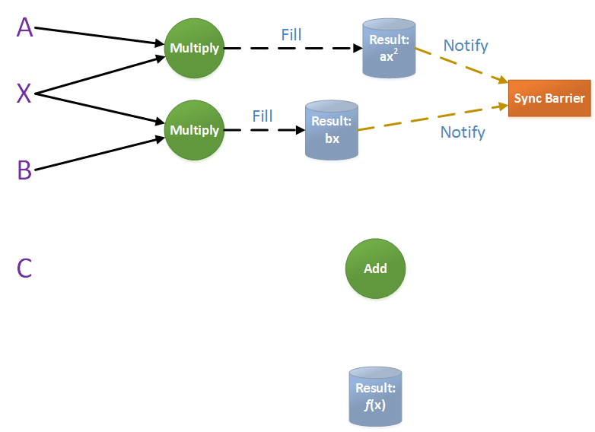
Google Pipeline API Example – Phase #1
Solving a polynomial equation:
f (x) = ax² + bx + c

Slide 30
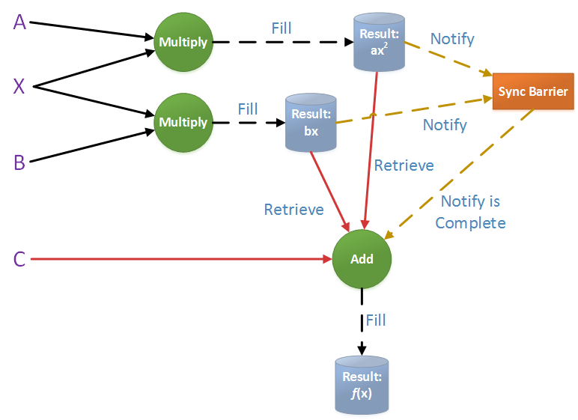
Google Pipeline API Example – Phase #2
Solving a polynomial equation:
f (x) = ax² + bx + c

